Slide 1
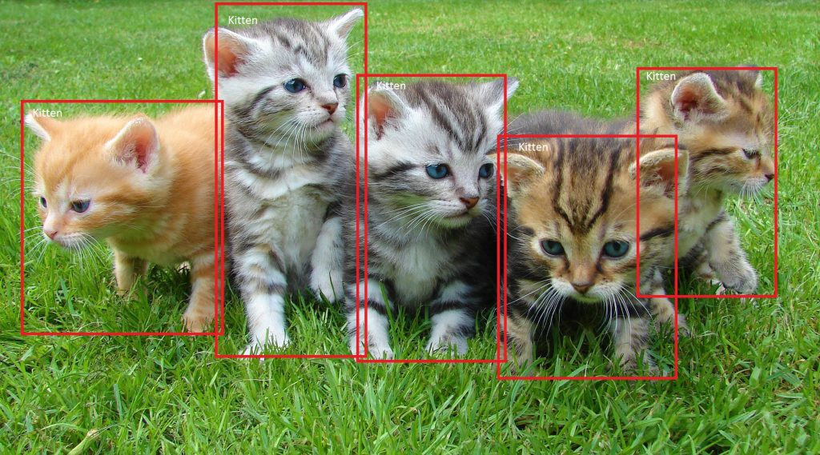
SSD: Single Shot MultiBox Detector 29 Dec 2016 UNC Chapel Hill, Zoox Inc., Google Inc. and University of Michigan, Ann-Arbor
Daniel Kovachev & Yuval Amrami
Example of end-to-end object detection in a Box (from Microsoft)

Slide 2
Older models
R-CNN
Training the data is unwieldy and too long
Training happens in multiple phases (e.g. training region proposal vs classifier)
Network is too slow at inference time (i.e. when dealing with non-training data)
YOLO

Slide 3
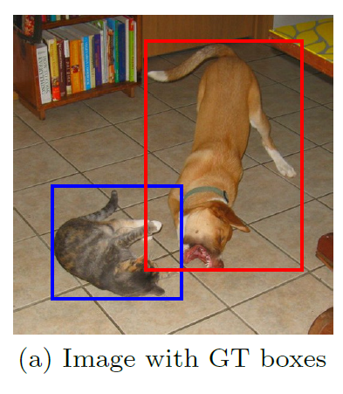
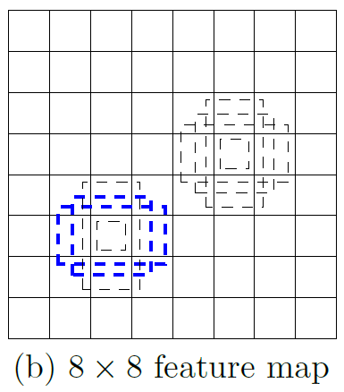
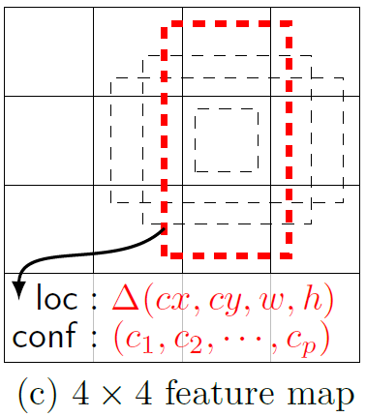
Single Shot MultiBox Detector
74% mAP (mean Average Precision) at 59 frames per second on standard datasets such as PascalVOC and COCO
Single Shot: The tasks of object localization and classification are done in a single forward pass of the network
MultiBox: the name of a technique for bounding box regression, developed by Szegedy et al.
Detector: The network is an object detector that also classifies those detected objects
(from SSD paper)

Slide 4
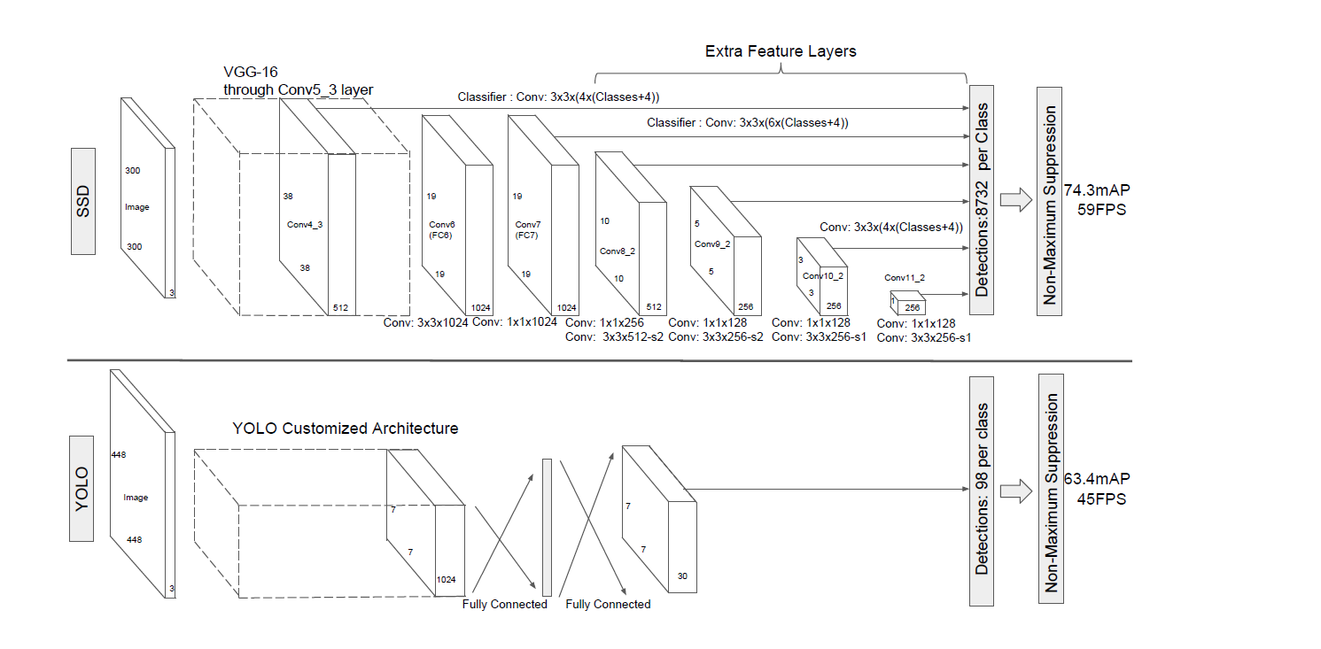
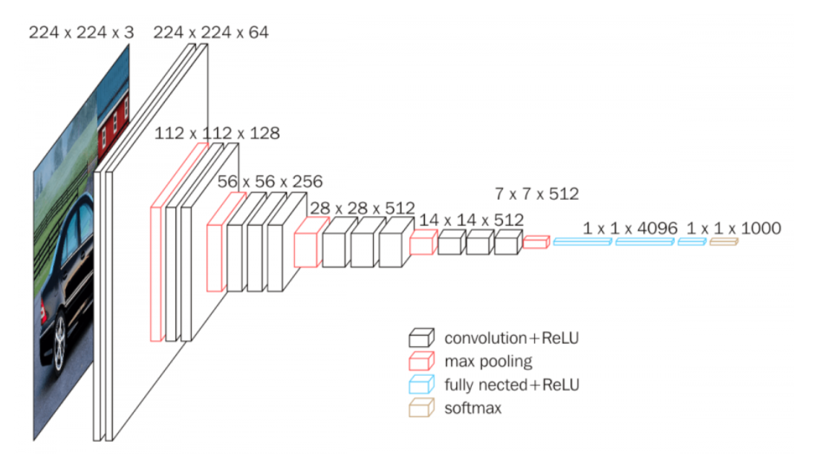
Architecture
SSD and YOLO architecture (from SSD paper)
VGG-16 architecture (from Neurohive)
Notes:
VGG-16 נבחרה בגלל יעילות אבל הופרדה משכבות מחוברות לחלוטין לשכבות עזר בממדים שונים

Slide 5
References
Understanding SSD MultiBox — Real-Time Object Detection In Deep Learning by Eddie Forson, Nov 18, 2017
Click to edit Bullet Point
Click to edit Bullet Point
Click to edit Bullet Point
Click to edit Bullet Point
Click to edit Bullet Point

Slide 6
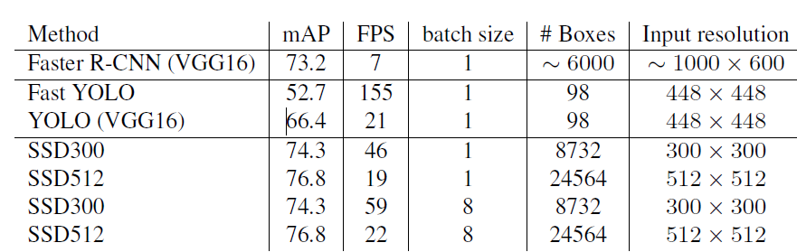
מה עוד
תהליך אימון?
סינון תוצאות עם כמות התאמות גדולה?
מתמטיקה?
תוצאות על המאגרים השונים?
תיאור של ההשוואה בין מולטי בוקס לSSD?
דוגמאות
נקודות תורפה שנשארו במערכת?
Click to edit Bullet Point
Click to edit Bullet Point
Click to edit Bullet Point
Click to edit Bullet Point
Click to edit Bullet Point

Slide 7

Thank you.

Slide 8
Text slide
Click to edit Bullet Point
Click to edit Bullet Point
Click to edit Bullet Point
Click to edit Bullet Point
Click to edit Bullet Point
Click to edit Bullet Point

Slide 9
Text slide
Subtitle
Click to edit Bullet Point
Click to edit Bullet Point
Click to edit Bullet Point
Click to edit Bullet Point
Click to edit Bullet Point
Click to edit Bullet Point

Slide 10

Text + Picture
Click to edit Bullet Point
Click to edit Bullet Point
Click to edit Bullet Point
Click to edit Bullet Point
Click to edit Bullet Point
Click to edit Bullet Point

Slide 11

Text + Picture 2
Click to edit Bullet Point
Click to edit Bullet Point
Click to edit Bullet Point
Click to edit Bullet Point
Click to edit Bullet Point
Click to edit Bullet Point

Slide 12

Text + Picture 3
Click to edit Bullet Point
Click to edit Bullet Point
Click to edit Bullet Point
Click to edit Bullet Point
Click to edit Bullet Point
Click to edit Bullet Point

Slide 13

Text + Picture 4

Slide 14
Graph slide

Slide 15
Graph slide
Click to edit Bullet Point
Click to edit Bullet Point
Click to edit Bullet Point
Click to edit Bullet Point
Click to edit Bullet Point
Click to edit Bullet Point
Graph title

Slide 16
Icon bank

Slide 17
Icon bank

